Slide 1
WRAPPING UP TOK
BQ6 Experts Lesson 12
I can discuss the value of education, referring to the key terms, ideas, and thinkers from the TOK course
Notes:
See how this lesson links to the course by viewing the final slide
Key TOK terms appear in a red font

Slide 2
Starter
What was BQ6?
List one key idea we considered, and one key thinker we met.
Notes:
Debrief responses.
BQ6 is “How do we become discerning knowers?”
Thinkers and ideas are listed on next slide.
The image links to our lesson on ‘Being multi-local’ - and the myth of national identities.

Slide 3
“What the hell is water?”
Listen to David Foster Wallace’s commencement speech at Kenyon College
What do you think his parable meant?
Notes:
Play DFW’s commencement speech from 15 seconds - 25 seconds.
Play a second time.
Let students think and share ideas.

Slide 4
What & who we’ve looked at in BQ6
Socrates
Lord Byron
Antonio Damasio
Michael Mosley
David Hume
Daniel Kahneman
Brian Cox
Hans Rosling
Jim Al-Khalil
Karl Popper
Taiye Selasi
Hannah Critchlow
John Oliver
Keith Whittington
John Stuart Mill
David Foster Wallace
Discerning
Reason
Induction and deduction
Syllogisms
Logical fallacies
Unpacking the prescribed essay titles
Structuring a TOK essay
The three interactions
Emotion vs. feelings
Gut reactions
Intuition
Thinking fast & slow
The Monty Hall problem
Gravity
Statistics vs. intuition
Scepticism
Doubt and certainty
Falsification
Multi-localism
The ‘3 Rs’ of identity
Fitting the facts into pre-prepared narratives
Humility and learning
Awareness
Notes:
Give students plenty of time to review this in groups. Check notes if necessary!
All tables should be able to briefly outline any/all of the ideas and thinkers - and link many of ideas to the thinkers.
Cold call, and reward accurate answers!

Slide 5
Kahoot!
Get into the same teams as last time.
Answer the Kahoot questions on BQ6...
Notes:
Kahoot is here.
Do this twice. Once in class, during which you can explain the answers. Then ask the students to do it again on their own.

Slide 6
“What is the capital ‘T’ truth about life?”
“The real value of a real education, which has almost nothing to do with knowledge, and everything to do with simple awareness; awareness of what is so real and essential, so hidden in plain sight all around us, all the time, that we have to keep reminding ourselves over and over: this is water, this is water.”
Notes:
Now listen (here) from 21.30 - 22.43.
What is the ‘capital T truth about life?’
What role does education (and, dare we say it, critical thinking/TOK) play in helping us realise that truth?
Is it, at the end, not about knowledge, but about something even more important - awareness?
This short activity/profound point (it’s a poignant moment - the last ever TOK class!) replaces the usual Tweet activity that we include the the BQs.

Slide 7
Is the point of theory of knowledge, after all, not about ‘knowledge’, but actually about ‘awareness’?
Notes:
See the BQ6 assessment tracker for suggestions on providing feedback, and recording students’ progress.

Slide 8
Linking this lesson to the course
During this lesson, we consider the highlighted aspects of the TOK course
The images used in the presentation slides can also give students ideas about selecting exhibition objects; see also our link below to specific IA prompts
CORE THEME | OPTIONAL THEMES | AREAS OF KNOWLEDGE | TOK ASSESSMENT
Knowledge & the knower | Indigenous societies | The arts | The TOK essay
 | Language | History
 | Politics | The human sciences | The TOK exhibition Could be linked to a lot of the prompts, as this lesson wraps up the BQ
 | Religion | Mathematics
 | Technology | The natural sciences

Slide 9
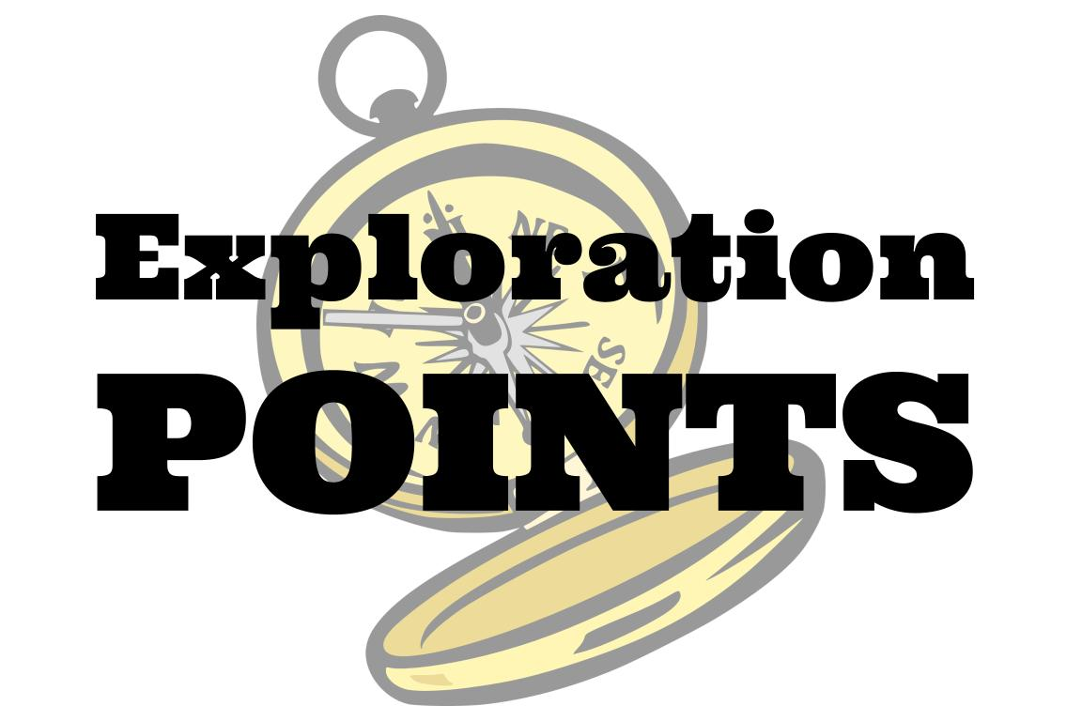
Explore the TOK themes and areas of knowledge in more depth via a range of thinkers, media sources, and other resources, in our EXPLORATION POINTS DOCUMENTS.
Access the documents via the links below. You’ll also find the EP icons on all of the TOK course pages of the site to help you unpack the quotes, KQs, and real-life situations that you find there.
CORE THEME
Knowledge & the knower
OPTIONAL THEMES
Indigenous societies
Language
Politics
Religion
Technology
AREAS OF KNOWLEDGE
The arts
History
Human sciences
Mathematics
Natural sciences
Notes:
Use this slide to access the ‘Exploration Points’ notes for BQ6, which will help students to develop a deeper knowledge of any TOK theme or area of knowledge. This will not only help them to master the TOK course in general, but also craft a great exhibition or essay.
Be ready to provide more guidance on how to use this resource - ie, which media sources to focus on, which questions to address, which TED talks to watch, and which key terms and ideas to understand.

